Slide 1
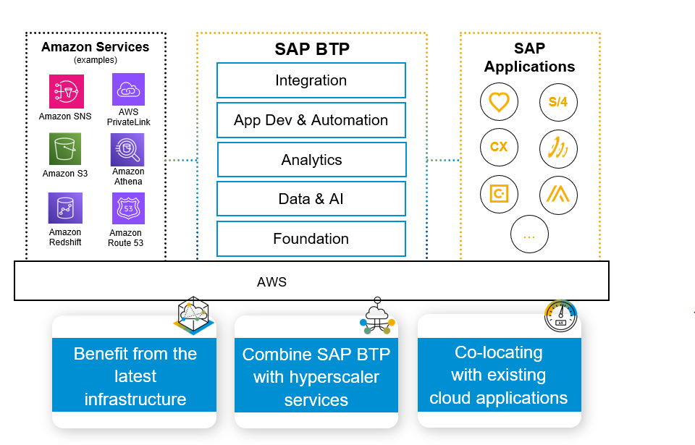
Joint reference architecture (JRA) introduced to address questions coming from customers and partners on architectural choices for solving business needs. Solution recommendations based on: foundation, data, integration and application development capabilities Guiding principles by capability for customer and partner decision making Customers benefit from faster time-to-value and lower total-cost-of-ownership
SAP BTP and AWS –
Joint Reference Architectures
Notes:
With a plethora of AWS services , solutions and SAP BTP services, customers are often in need of guiding principles on assembling these services to gain meaningful business outcomes. AWS and SAP have partnered to provide solution recommendations and guiding principles for use cases including and not limited to – connectivity, Full stack application development, Internet of things, Machine learning, Devops and Generative AI.

Slide 2



AWS Missions on SAP Discovery Center
Implement use cases on SAP Business Technology Platform with step-by-step guidance
Foundation
Architecting multi-region resiliency for SAP BTP use cases
Secure Connectivity with Private Link Service
Demonstrates how SAP Private Link service can be used to securely communicate with an SAP S/4HANA from SAP BTP, Cloud Foundry environment on AWS.
Leverage AWS Route53 traffic management service to route the traffic intelligently to different SAP BTP service.
Integration
Gen AI
Integrate events from Amazon Monitron with SAP S/4HANA using SAP BTP
Integrate Amazon Rekognition and SAP EHS for PPE Detection
Build Gen AI Application with RAG on SAP BTP and Amazon Bedrock
Learn more
Event-driven architecture based application for integrating events from Amazon Monitron to SAP BTP leveraging SAP Advanced Event Mesh and SAP S/4HANA for business actions.
Analyze images with Amazon Rekognition PPE detection and trigger events to SAP EHS using SAP BTP’s Advanced Event Mesh and Events-To-Business Actions Framework.
Implement Retrieval Augmented Generation(RAG) GenAI applications on SAP BTP using LLM Models from Amazon Bedrock
Data & Analytics
Integrate Amazon Athena with SAP Datasphere
Accessing data in Amazon S3 from SAP Datasphere
Data Federation from Amazon Redshift through SAP Datasphere
Predict Inventory Allocation with Amazon Sagemaker and FedML
Integrate Amazon S3 data with SAP Business Data in SAP Datasphere thought federated Amazon Athena queries.
Access Amazon S3 data in SAP Datasphere by configuring direct connections for data federation.
Build unified data models using data federation from Amazon Redshift to SAP Datasphere using Smart Data Integration.
Explore SAP Datasphere and FedML-AWS Library to source data, build, train and deploy machine learning models on Amazon Sagemaker.

Slide 3
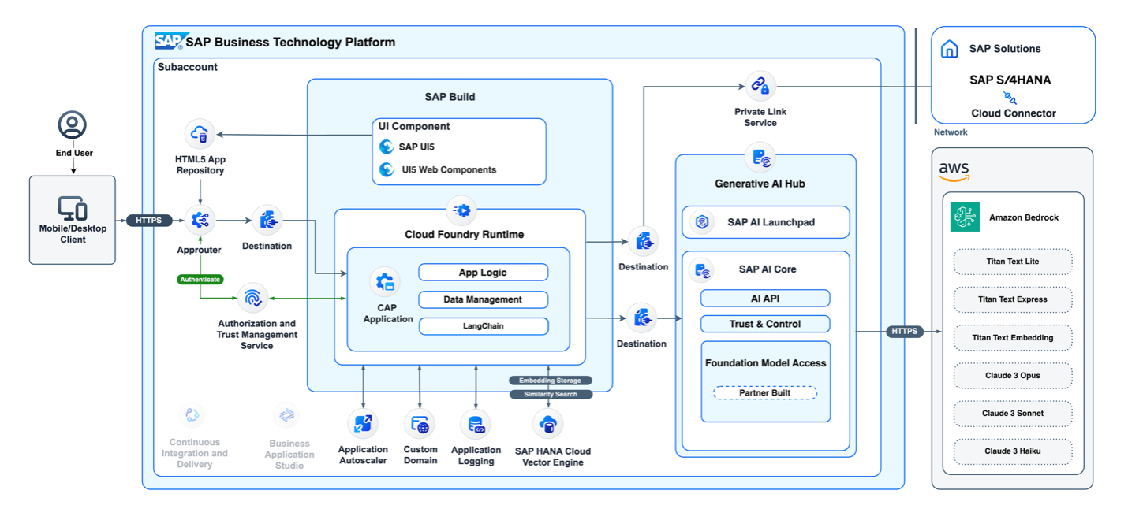

Secure and scalable access to generative AI
Notes:
SAP and AWS have provided a reference architecture to our customers for consuming generative AI capabilities of Amazon Bedrock with SAP BTP. Using this architecture, SAP workloads can now be supplemented with large language models (LLMs) and transformer model capabilities to harness the power of SAP data, resulting in improved insights and operational efficiencies at a lower cost.
From: https://aws.amazon.com/blogs/awsforsap/power-your-business-with-secure-and-scalable-generative-ai-services-from-aws-and-sap/

